Slide 1
RUMUAHIA - REVAMP AHIA FLOW STATION PERIMETER LIGHTING SYSTEM(DIY)
Charter Template
Business Case/objectives:
Illumination of Ahia f/s is very poor due to the number of burnt light bulbs and defective lighting fittings in the facility. The poor illumination has made movement by facility wardens on night duty difficult. To get this poor illumination fault fixed, the Maintenance Execution Contractor submitted a quote of $20,134.50 =₦ 6,168,204.075
Total cost of repairs as assessed by Asset team, using P-card to order material is $2,573.53= ₦788,400.00
Considering the hugh difference in costs submitted, this project seeks to revamping Ahia Flow station Perimeter lighting system as a DIY.
Potential Benefits & Measurement:
Improve Illumination level of the station
Reduce potential for security exposures
Create safe and comfortable working environments
Cost Saving for the PU
Project Scope/Actions :
Scoping and Execution cost estimation by the Corporate maintenance team/ Contractors
Scoping and Execution cost estimation by the Asset team
Costs Review/overview and decision making
Development of work execution timeline/schedule
Sourcing/Procurement of required materials for the project execution
Project/work execution and commissioning
Demobilization
Critical Success Factors:
Availability of Technical Know-how
Availability of funds
Locally sourced materials
Management Commitment and support
High-level Timeline:
L0-L1: (See definition of L1 – L5 in the next slide)
L2:
L3:
L4: June,2019
L5:August,2019
Initiative End
Project Sponsor: Wilcox Emmanuel /Aniemeke Samuel
Implementation Lead: Opara Darlington
Project Team: Ogbonnaya Ariwodo
Adedokun Rasaq; Hart Alaidanengia; Obi Fortune; Franklin Okoronkwo; Sampson James and Olatunbosun Dahunsi

Slide 2
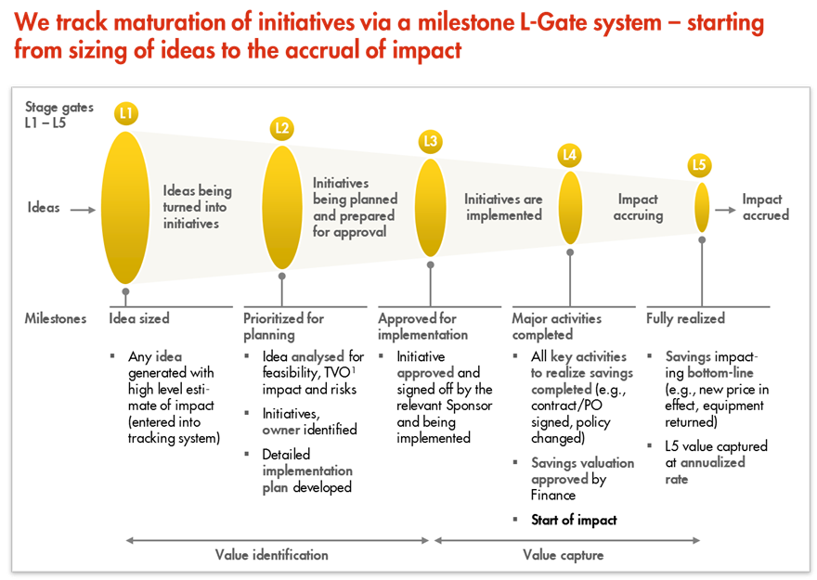
L1 – L5 Gates

